Slide 1
Compilation Techniques (6)
Abstract Syntax Tree
Semantic Actions
Attributes
Syntax-Directed Translation Scheme
Loaders
© Codruta-Mihaela ISTIN 2015

Slide 2
Abstract Syntax Tree (AST)
A visual representation of a syntax concept
Example: a declaration of an integer array variable:
  C/C++: int v[10];
  Visual Basic: Dim v(10) As Integer
Even if the syntax is different, the concept is the same, so we can abstract the concept from syntax:
As a difference from parse trees (which hold all the parsed elements including commas, dots, parenthesis, semicolon, …), an AST holds only the elements required to define the concept
VarDecl
Type | Name: v
TypeArray
ElementType | Size: 10
TypeBase
int
© Codruta-Mihaela ISTIN 2015

Slide 3
AST usage
ASTs can be used to define the concepts represented by a grammar
Every use of a concept in a program (ex: declarations, statements, expressions, …) can be seen as a node of a specific type
Each node type can be implemented as a struct/class, possibly with a common base
FunctionDecl
Type | Name: main | Arguments: [] | Body
TypeBase
void
Call
Name | Arguments: [ ]
Id
printf
String
“hi there\n”
© Codruta-Mihaela ISTIN 2015

Slide 4
AST construction
AST is constructed during the syntactic analysis
The construction can be:
  explicit – the AST is implemented as a tree which is dynamically created during parsing. A full AST results after the syntactic analysis and this AST can be processed further. This method provides a good decoupling between the syntactic analysis and the next compiler phases. These phases will use only the AST.
  implicit – by using the Recursive Descent Parsing (RDP) algorithm properties, without explicitly creating the AST objects. In this method each nonterminal call of the RDP algorithm is roughly equivalent with an AST node creation. A predicate return is equivalent with an AST node deletion. This method is suitable for simpler grammars/compilers.
In the implicit construction, the context created by a predicate call (its local declarations) serves as an ad-hoc object which holds the information necessary for that nonterminal. All the processing for a grammar construct must be made inside this call or else some information must be saved or send back to the predicate caller, for further processing
© Codruta-Mihaela ISTIN 2015

Slide 5
Implicit AST construction
void main(){printf(“hi there\n”);}
Call history:
FunctionDecl
  TypeBase – “void” must be preserved
  Call – “printf” and “hi there\n” must be preserved
    Id – “printf” must be preserved
    String – “hi there\n” must preserved
© Codruta-Mihaela ISTIN 2015

Slide 6
Semantic actions
Sequences of code embedded in grammar
In its pure form, a syntactic analyzer only checks if the input tokens are correctly ordered according to the grammar rules. If errors are found they are reported, else an “OK” is generated.
Semantic actions can be embedded in grammar in order to do something else besides input syntax check
Syntax-Directed Translation Scheme (SDTS) – a grammar which contains semantic actions
© Codruta-Mihaela ISTIN 2015

Slide 7
Attributes
Named values which can be sent into a rule or can be returned from a nonterminal or token (terminal)
The attributes are a method to link the semantic actions with the values given by tokens or nonterminals
Inherited attributes – attributes which are computed before the execution of the rule and are passed into rule
Synthesized attributes – attributes which are computed inside a rule (possibly also in its called rules) and are returned from that rule
Analogy with a function: the inherited attributes are the input arguments and the synthesized attributes are the returned values
© Codruta-Mihaela ISTIN 2015

Slide 8
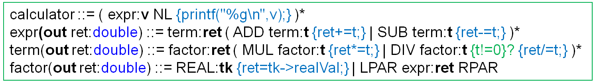
Notations
head(attrDef1, attrDef2, …) ::= … – the current rule head can have the following types of attributes attached:
  in attrName:type – inherited attribute
  out attrName:type – synthesized attribute
nonterminal:(a1,a2,…) or nonterminal:a – the attribute(s) are sent (the inherited ones) or received (the synthesized ones) if that nonterminal is matched. The type is implicit from that nonterminal type
token:var – the variable is set to the corresponding token
{…} – a semantic action (any code)
{…}? – a semantic predicate (an expression which can be tested in “if”)
© Codruta-Mihaela ISTIN 2015

Slide 9
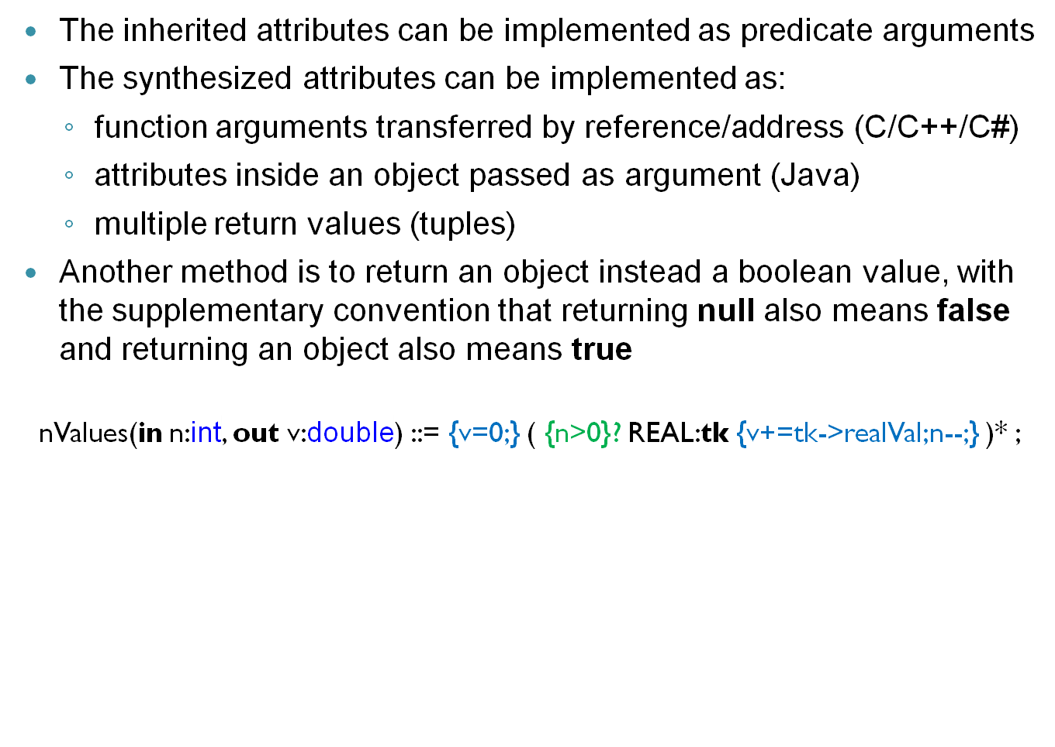
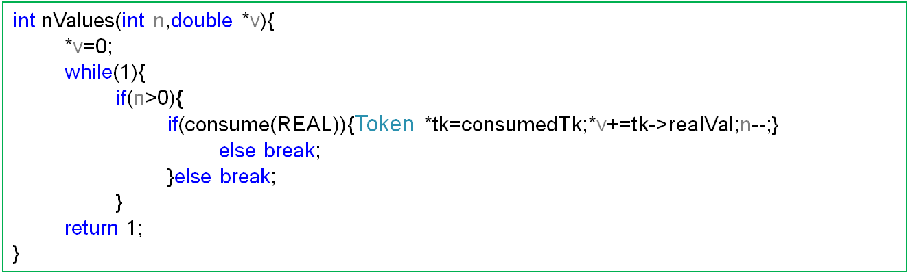
Attributes implementation
© Codruta-Mihaela ISTIN 2015

Slide 10
Semantic actions execution
A semantic action must be executed only if it is certain that the rule will match the path of the semantic action, or else there must be a way to be able to undo that action
Counter example:
stm ::= {printf(“declaration”);} ID ID
| {printf(“assignment”);} ID ASSIGN expr
In this example “printf” is executed before knowing for sure what to print so it can output the wrong message. This cannot be undone
Fixed example:
stm ::= ID ID {printf(“declaration”);}
| ID ASSIGN {printf(“assignment”);} expr
In this version is enough information before “printf” so it will always print the correct message
© Codruta-Mihaela ISTIN 2015

Slide 11
Semantic actions as grammar parts
A semantic action always acts as a successful matched grammar part
Consequences:
  A semantic action inside a sequence does not alter the sequence meaning
  A semantic action as an alternative offers a path which is always matched
stm ::= IF {printf(“if”);} LPAR expr RPAR stm
| LACC {printf(“block”);} stm* RACC
| {printf(“invalid statement”);exit(-1);}
© Codruta-Mihaela ISTIN 2015

Slide 12
Custom formats loaders
Sometimes an application needs to load files with a complex format which cannot be handled by regular expressions (ex: formats which contains recursive structures)
If data is formatted in standard formats (ex: JSON, XML), it can be easily loaded using standard libraries
If more features are needed and these cannot be easily encoded using a standard format, a custom format is needed and parsing techniques must be employed in order to read that format
In this kind of applications a parser with semantic actions suffices to read the input data
© Codruta-Mihaela ISTIN 2015

Slide 13
Loader example
Format description: a database keeps a list of objects. Each object can have child objects, in an hierarchical manner. An object is enclosed in accolades and it can have any number of attributes given as values assignments to IDs, without any separator. A value can be: a number, a string inside quotes, a list or another object. A list contains values, it is enclosed in brackets and its elements are not separated by any delimiter.
Example:
[{ type=“PC”
graphics={OpenGL=4.5 GB=2}
cpu={cores=4}
others=[“mouse” “keyboard” “monitor”]
}
{type=“printer” color=“yes” technology=“laser”}
]
© Codruta-Mihaela ISTIN 2015

Slide 14
Loader lexical rules
ID ::= [a-zA-Z_] [a-zA-Z0-9_]* ;
NUMBER ::= [0-9]+ ( ‘.’ [0-9]+ )? ;
STRING ::= ‘”’ [^”]* ‘”’ ;
LACC ::= ‘{‘ ;
RACC ::= ‘}’ ;
LBRACKET ::= ‘[’ ;
RBRACKET ::= ‘]’ ;
ASSIGN ::= ‘=‘ ;
SPACES ::= [ \r\n\t] ; // these are discarded
© Codruta-Mihaela ISTIN 2015

Slide 15
Loader syntax rules
database ::= list ;
list ::= LBRACKET value* RBRACKET ;
value ::= NUMBER | STRING | object | list ;
object ::= LACC ( ID ASSIGN value )* RACC ;
© Codruta-Mihaela ISTIN 2015

Slide 16
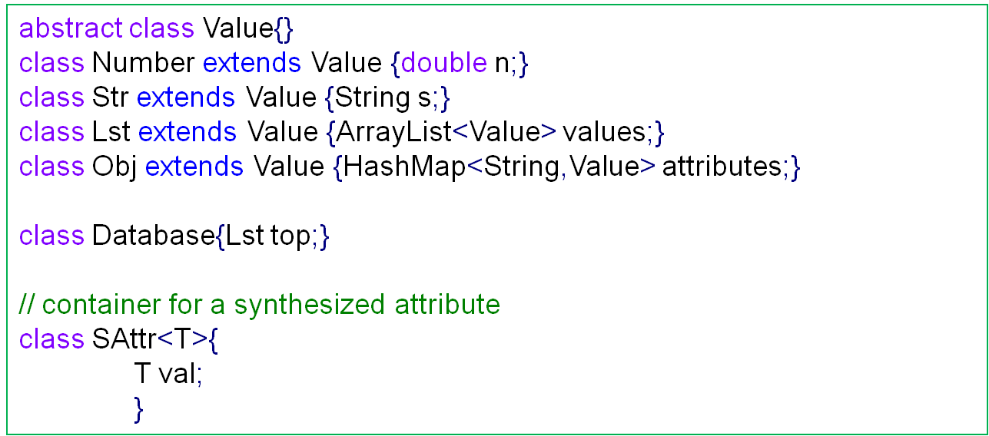
Loader host database (Java)
© Codruta-Mihaela ISTIN 2015

Slide 17
Loader semantic actions
database(in db:Database) ::= list:(db.top) ;
list(out list:Lst) ::= LBRACKET
( value:v {list.add(v);} )*
RBRACKET ;
value(out v:Value) ::=
NUMBER:tkn {v=new Number(tkn.realVal);}
| STRING:tks {v=new Str(tks.text);}
| object:v
| list:v ;
object(out o:Obj) ::= LACC {o=new Obj();} (
ID:tkName
ASSIGN
value:v {o.attributes.put(tkName.text,v);}
)* RACC ;
© Codruta-Mihaela ISTIN 2015

Slide 18
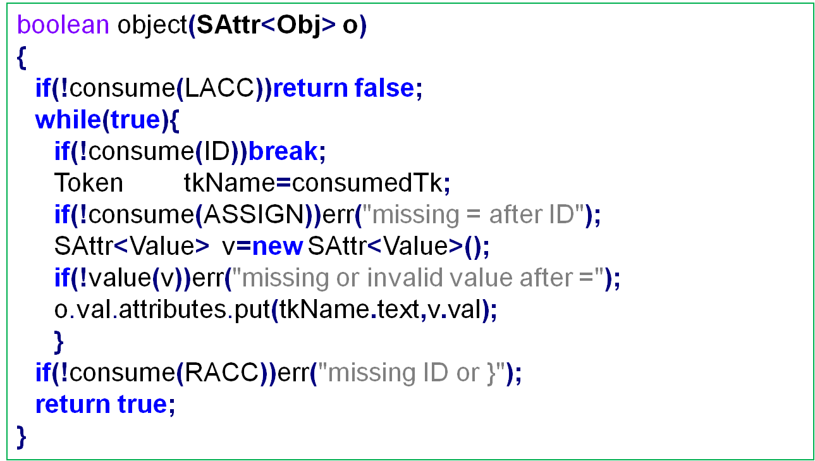
Loader implementation
© Codruta-Mihaela ISTIN 2015

Slide 19
Bibliography reading
Compilers. Principles, Techniques and Tools
5.1, 5.4
© Codruta-Mihaela ISTIN 2015

